Slide 1





HOSPITAL MANAGEMENT SYSTEM
Team Members:
R. Anusha (Lead)
K. Janani Priya
G. Lavanya
S. Sathishkumar
C. Sivabala
Guide: Ms. Uma Maheshwari.
Disclaimer: The content is curated for educational purposes only.

Slide 2
HOSPITAL MANAGEMENT SYSTEM
Abstract
Problem Statement
Aims, Objective & Proposed System/Solution
System Design/Architecture
System Development Approach (Technology Used)
Algorithm & Deployment
Conclusion
Future Scope
References
Video of the Project

Slide 3
Abstract
The Hospital Management System project aims to address challenges faced by the healthcare industry, including inefficiency, data disorganization, billing errors, and communication gaps. The system comprises distinct components for Electronic Health Records (EHR), Appointment Scheduling, Prescription Tracking, and Telemedicine functionalities.
Leveraging HTML for structure, CSS for styling, and React.js for dynamic behavior, the system prioritizes user-friendly interfaces for healthcare professionals and patients. Automated reminders for healthcare professionals and patients enhance the user experience, and an intuitive workflow streamlines scheduling, modifications, and cancellations.
In the Prescription Tracking component, a user-friendly interface empowers healthcare professionals to manage and track prescriptions accurately. Features include prescription history, automated refill reminders, and integration with pharmacies, ensuring compliance with industry standards. The Telemedicine component seamlessly integrates video consultations, secure messaging, and file sharing for remote patient-doctor interactions.
An accessible interface for both healthcare professionals and patients, coupled with real-time communication capabilities, ensures a high-quality telemedicine experience.

Slide 4
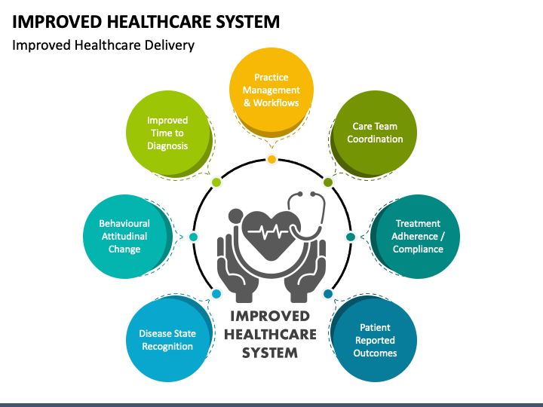
Problem Statement Healthcare faces challenges such as inefficiency, data disorganization, billing errors, and poor communication, hindering effective patient care and resource management.

Slide 5
Aim:
The primary goal or purpose is to develop a E-healthcare management system.
Objectives:
Information Accessibility:
Provide a centralized platform for easy access to healthcare information for patients, healthcare professionals, and administrators.
Appointment Scheduling:
Implement a user-friendly system for patients to schedule and manage appointments online, improving convenience and reducing administrative workload.
Electronic Health Records (EHR) Integration:
Integrate electronic health records to facilitate secure and seamless sharing of patient information among healthcare providers.
Telemedicine Integration:
Incorporate telemedicine features to enable virtual consultations, expanding access to healthcare services and improving patient convenience.

Slide 6
User-Friendly Interface:
Design an intuitive and user-friendly interface for easy navigation, ensuring that users can quickly find relevant information and services.
Mobile Responsiveness:
Ensure the website is optimized for mobile devices, allowing users to access healthcare information and services on smartphones and tablets.
Security and Privacy:
Implement robust security measures to safeguard patient data and ensure compliance with healthcare privacy regulations such as HIPAA.
Health Education and Resources:
Provide educational content and resources to empower patients with information about preventive care, treatment options, and healthy living.
Feedback and Surveys:
Incorporate feedback mechanisms and patient satisfaction surveys to continuously improve the website and healthcare services.
Billing and Payment Integration:
Streamline billing processes by integrating secure online payment options, reducing administrative burdens and improving the patient experience.

Slide 7
Proposed Solution Design and Implement Healthcare Management System Components. To Develop a comprehensive Healthcare Management System comprising distinct components for Electronic Health Records (EHR), Appointment Scheduling, Prescription Tracking, and Telemedicine functionalities. Each component should have a user-friendly interface implemented using HTML for structure, CSS for styling, and React.js for dynamic behavior. Implementing an integrated electronic health record (EHR) system can streamline data management, reduce errors, and enhance communication among healthcare providers, ultimately improving patient care and optimizing resource allocation. FRONTEND: HTML, CSS, PHP. BACK-END: SQL.

Slide 8
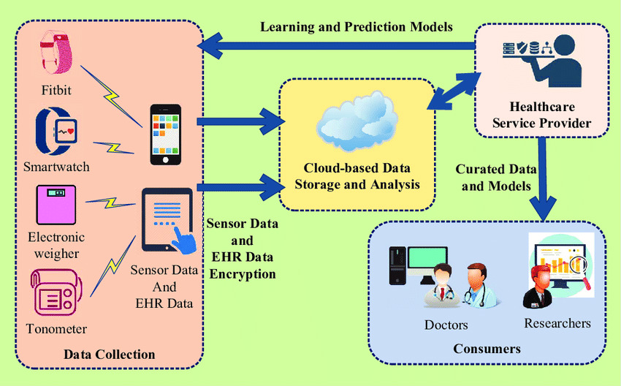
System Architecture

Slide 9
System Deployment Approach
Agile development:
This approach emphasizes iterative development with short feedback loops. This allows for early and frequent testing and delivery of features, which can be helpful in a rapidly changing field like healthcare.
Cloud computing:
Cloud-based systems can provide scalability, flexibility, and security for healthcare management systems. They can also make it easier to share data between different healthcare providers.
Big data:
Healthcare systems generate a lot of data, which can be used to improve patient care, reduce costs, and identify trends. Big data analytics tools can help healthcare providers make sense of this data and use it to their advantage.
Machine learning:
Machine learning can be used to automate tasks such as scheduling appointments, coding diagnoses, and predicting patient outcomes. This can free up healthcare providers to spend more time with patients.

Slide 10
Algorithm:
Scheduling algorithms: Match patient appointments with available doctors and resources, considering factors like urgency, expertise, and location.
Resource allocation algorithms: Allocate limited resources (beds, equipment, staff) efficiently based on patient needs and priorities.
Decision support algorithms: Analyze patient data and medical history to suggest diagnoses, treatment options, and potential risks.
Predictive modeling algorithms: Forecast future patient demand, resource utilization, and potential outbreaks to inform resource planning and allocation.
Development:
Planning and requirement analysis: Defining system goals, functionalities, and user needs.
System design and architecture: Determining the system's overall structure, data models, and technical components.
Development and testing: Building and testing individual modules and integrating them into a cohesive system.
Deployment and training: Implementing the system in the healthcare facility and providing user training.
Maintenance and support: Ongoing monitoring, maintenance, and updates to ensure system performance and security.

Slide 11
Conclusion
The implementation of a robust health care management system is pivotal for enhancing overall healthcare efficiency and patient outcomes.
By seamlessly integrating electronic health records, streamlining administrative processes, and fostering communication among healthcare providers, the system facilitates a more coordinated and patient-centric approach.
This leads to reduced errors, improved resource allocation, and ultimately, better healthcare delivery. Additionally, the utilization of data analytics within the system allows for informed decision-making, proactive healthcare planning, and the identification of trends for continuous improvement.
As technology continues to advance, investing in and evolving such systems becomes crucial for staying at the forefront of healthcare management and ensuring the well-being of both providers and patients.

Slide 12
Future Scope
Integration of AI and Machine Learning: Expect further integration of AI and machine learning algorithms for predictive analytics, personalized treatment plans, and improved diagnostics. This can enhance decision-making processes and optimize resource utilization.
IoT in Healthcare: The Internet of Things (IoT) will play a larger role, enabling real-time monitoring of patients through wearable devices and smart sensors. This fosters remote patient management, preventive care, and timely interventions.
Patient Empowerment through Health Apps: A surge in health apps and patient portals will empower individuals to actively manage their health, facilitating better communication with healthcare providers, appointment scheduling, and access to personal health records.
Advanced Data Analytics: Continued advancements in data analytics will enable healthcare organizations to extract meaningful insights from large datasets. This can aid in trend analysis, identifying high-risk populations, and tailoring interventions based on predictive modeling.
Collaboration and Interoperability: Enhanced collaboration among different healthcare entities and improved interoperability will be key, allowing seamless information exchange and coordination among various stakeholders for comprehensive patient care.

Slide 13
Reference
Healthcare Information and Management Systems Society (HIMSS): https://www.himss.org/
Notes:
13

Slide 14
Thank you!
Notes:
14

